Slide 1
Introduction to Information Systems and Programming
Java Introduction

Slide 2
Java syntax is relatively simple, and Java is very portable
Simple syntax
Java BNF (Syntax): 50 rules
C++ BNF: 140 rules
BNF: Backus Normal Form: A technique to describe the syntax of programming languages

Slide 3
Java syntax is relatively simple, and Java is very portable
Portable
can run on any computer / device with Java virtual machine (JVM)
E.g. Python is great, but don’t work on all platform

Slide 4
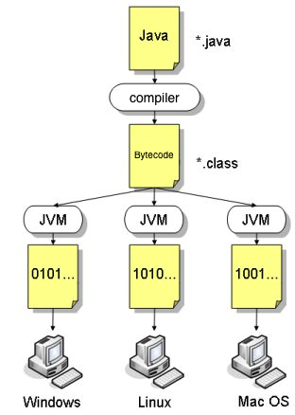
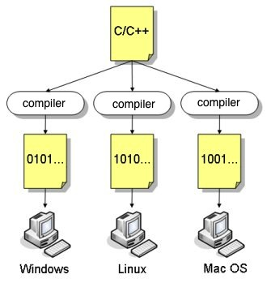
About JAVA’s portability
-High-level programming languages have to be translated into machine-language before the program can be executed
-By compiler
Machine codes are platform-specific, not portable, not suitable for connected computers

Slide 5
About JAVA’s portability
-Java programs are compiled into a specific type of machine language called bytecode
-Bytecode can be run on any computer with a JVM
-JVM: a software that interprets Java bytecode

Slide 6
Android Studio
We use Android Studio to program JAVA
IDE = Integrated development Environment: edit, compile, build, debug, etc
Other IDE: Eclipse

Slide 7
Android Studio: Create Project
File -> New -> New Project
Select the form factors: Phone and Tablet
Select ‘No Activity’
Application name: MyApp01
Minimum SDK: API 21
View -> Tool Windows -> Project

Slide 8
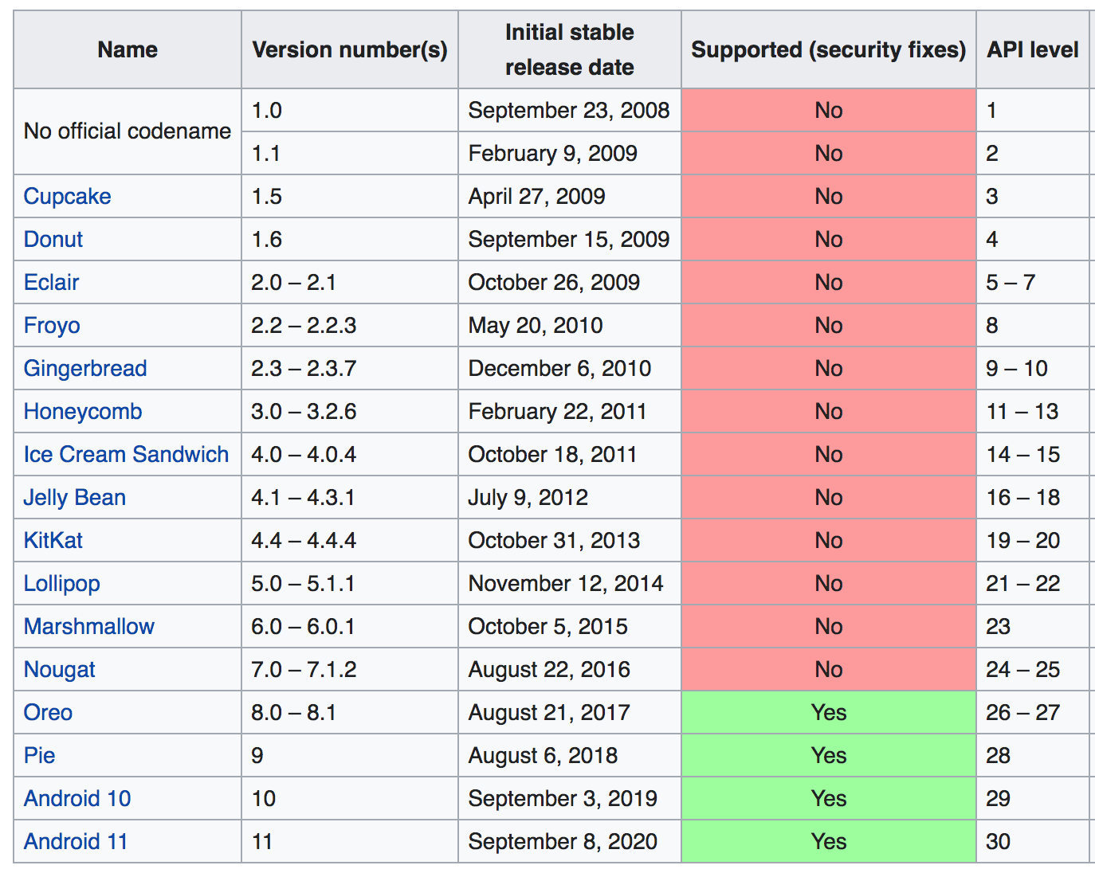
Android Studio: Create Project

Slide 9
Android Studio: Create Module
File -> New -> New Module
Choose ‘Java or Kotlin Library’
Library name: lib01
Class name: MyClass
To remove a module: File->Project structure, choose module, select ‘-’

Slide 10
public class MyClass {
public static void main(String[] args) {
System.out.println("Hello World”);
}
}
Every Java program must contain at least one class that defines the data and methods (functions)
JVM executes the program from the main method
void: does not have any return value
public: accessibility modifier; MyClass can be used anyway in the program

Slide 11
Android Studio: Run the program
Run -> Edit configurations
Select ‘+’ (Add new configuration) -> Application
Name: Java Application
Select <Project>.<module>
Main class: MyClass

Slide 12
Android Studio: Run the program
Error message "Android Gradle plugin requires Java 11 to run. You are currently using Java 1.8”
File -> Project Structure
SDK Location -> Gradle Settings
Gradle JDK -> Android Studio Java home version 11.0.10

Slide 13
1. Variables
Variables are used to store data in a program
In Java, you have to specify what type of data a variable represents: variable declaration
int a = 0;
int b = 1;
P.S. There are 4 types of variables:
- Non static
- Static
- Local
- Parameters
http://docs.oracle.com/javase/tutorial/java/nutsandbolts/variables.html

Slide 14
1. Variables
Class name usually start with Capital letter
class Demo {
public static void main(String[] args) {
int a = 0;
}
variable name usually start with small letter

Slide 15
2. array
-Array is used to store a collection of data
int[] c; // declare a variable to reference the array
c = new int[3]; // allocate memory for 3 int
c[0]=17; // assign value
c[1]=23;
c[2]=38;
System.out.println(“0th value:“+ c[0]);
System.out.println(“1st value:“+ c[1]);
System.out.println(“2nd value:“+ c[2]);
Concatenate string

Slide 16
Array – what’s happening behind
int[] c;
c = new int[3];
c[0]=17;
c[1]=23;
c
Type: int[]
c is declared as a variable of reference to an array (of integer)

Slide 17
Array – what’s happening behind
int[] c;
c = new int[3];
c[0]=17;
c[1]=23;
0th
1st
2nd
c
Type: int
Type: int
Type: int
Type: int[]
Three int memory are allocated. The array reference is assigned to c

Slide 18
Array – what’s happening behind
int[] c;
c = new int[3];
c[0]=17;
c[1]=23;
0th
1st
2nd
c
17
Type: int
Type: int
Type: int
Type: int[]
We assign value 17 to the c[0] memory cell
(not assign 17 to c. c is just a reference)

Slide 19
Array – what’s happening behind
int[] c;
c = new int[3];
c[0]=17;
c[1]=23;
0th
1st
2nd
c
17
23
Type: int
Type: int
Type: int
Type: int[]

Slide 20
3. String
-String is a sequence of characters
String d = “HelloXDD”;
int len = d.length();
System.out.println(d);
System.out.println(len);

Slide 21
3. String
class Demo {
public static void main(String[] args) {
String d = “HelloXDD”;
int len = d.length();
System.out.println(d);
System.out.println(len);
}
}
What is len?

Slide 22
3. String
class Demo {
public static void main(String[] args) {
String d = “HelloXDD”;
int len = d.length();
System.out.println(d);
System.out.println(len);
}
}
len is 8

Slide 23
3. String
Alternative way to create a String object
char[] dArray = { 'h', 'e', 'l', 'l', 'o', ’X’, ‘D’, ‘D’ };
String dString = new String(dArray);
System.out.println(dString);

Slide 24
4. If then
If-then-else: selective statements and conditional execution
int simonWeight = 99999; // in kg. OH NO….
String advice = “”; // this is an empty string
if (simonWeight <= 75) {
advice = “fit”;
} else if (simonWeight <= 100) {
advice = “eat less”;
} else if (simonWeight <= 150) {
advice = “no dinner”;
} else {
advice = “no dinner no breakfast no tea no lunch”;
}
What is the advice?

Slide 25
5. for-loop
Loop: program construct to control repeated execution of a block of statements
for(int i=1; i<=4; i++){
System.out.println("Count is: " + i);
}
Initial action
Loop continuation condition
Action after each iteration

Slide 26
5. for-loop
Loop: program construct to control repeated execution of a block of statements
for(int i=1; i<=4; i++){
System.out.println("Count is: " + i);
}
Initial action
Loop continuation condition
Action after each iteration
The output will be:
Count is: 1
Count is: 2
Count is: 3
Count is: 4

Slide 27
6. Method (function, operation)
Declare a method
class Demo {
public static void printHAHA() {
System.out.println(”HAHA”);
}
public static void main(String[] args) {
printHAHA();
}
}
Use a method

Slide 28
6. Method – with argument
name of method
class Demo {
public static void printa(int a) {
System.out.println(a);
}
public static void main(String[] args) {
printa(3);
}
}
argument
It will print out the number 3

Slide 29
6. Method – return a value
This method will return an int
class Demo {
public static int four() {
return 4;
}
public static void main(String[] args) {
int answer = four();
}
}
answer will be equal to 4

Slide 30
Reference of JAVA syntax
All can be found here:
http://docs.oracle.com/javase/tutorial/java/nutsandbolts/index.html

